Slide 1
Using storytelling in the language classroom online workshop with Richard Martin
Workshop aims
Gain confidence to tell freely

Slide 2
Using storytelling in the language classroom online workshop with Richard Martin
Workshop aims
Gain confidence to tell freely
Meet several folk tales to tell in class

Slide 3
Using storytelling in the language classroom online workshop with Richard Martin
Workshop aims
Gain confidence to tell freely
Meet several folk tales to tell in class
Learn where to find more tales and more methodology

Slide 4
Using storytelling in the language classroom online workshop with Richard Martin
Workshop structure
Three blocks
Block 1 – Watching what I do

Slide 5
Using storytelling in the language classroom online workshop with Richard Martin
Workshop structure
Three blocks
Block 1 – Watching what I do
Block 2 – Trying it yourself
Tell your tale to a partner

Slide 6
Using storytelling in the language classroom online workshop with Richard Martin
Workshop structure
Three blocks
Block 1 – Watching what I do
Block 2 – Trying it yourself
Tell your tale to a partner
Block 3 – Using it in class
Methodology

Slide 7
Using storytelling in the language classroom online workshop with Richard Martin
Performance mode - Paralanguage
Body language
Eye contact
Voice

Slide 8
Using storytelling in the language classroom online workshop with Richard Martin
The amateur tells the words

Slide 9
Using storytelling in the language classroom online workshop with Richard Martin
The amateur tells the words
The professional tells the story

Slide 10
Using storytelling in the language classroom online workshop with Richard Martin
The amateur tells the words
The professional tells the story
But the artist tells the listener!

Slide 11
Using storytelling in the language classroom online workshop with Richard Martin
Partner storytelling
2 minutes preparation
Before you go into the breakout room to tell your tale:
Remember the skeleton (not a text)
Remember you will use paralanguage to tell the story
Think of a good beginning sentence and ending

Slide 12
Using storytelling in the language classroom online workshop with Richard Martin
Partner storytelling
Approx. 20 min.
In your breakout room, with your video on, tell your partner your story.
Remember performance mode!
Remember NOT to look at a piece of paper!

Slide 13
Using storytelling in the language classroom online workshop with Richard Martin
Partner storytelling
Glows & Grows
After each story, the listener gives short feedback:
First something positive (to make the teller glow)
Then something to change (to help the teller grow)

Slide 14
Using storytelling in the language classroom online workshop with Richard Martin
Partner storytelling
When you have finished, return to the main meeting.

Slide 15
Using storytelling in the language classroom
online workshop with Richard Martin
Methodology
Some exercises based on my
Activity Teaching Packs
Details on the resources webpage
15

Slide 16
Using storytelling in the language classroom online workshop with Richard Martin
Vocabulary and discussion
Frightened Mouse
  I want…, Can I…, May I…, Please, may I…, Do you mind if…, I’d like to…,
  Thank you…, Thanks…, That is so kind of you…, I really like that. etc.
Discuss social behaviour – Are please and thank you important?

Slide 17
Using storytelling in the language classroom online workshop with Richard Martin
Picture/text production (for more advanced writing skills)
Students fold a sheet of paper to create 6 boxes. Pictures/words re-tell the story.
Task: Draw the story in 6 pictures and add some words
Picture 1 | Picture 2 | Picture 3
Picture 4 | Picture 5 | Picture 6

Slide 18
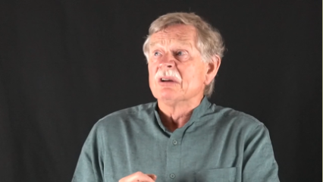
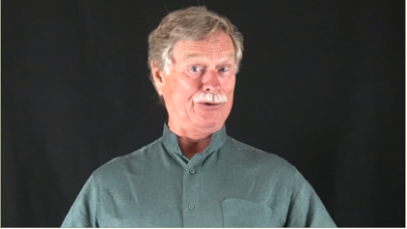
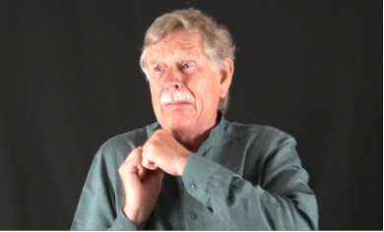
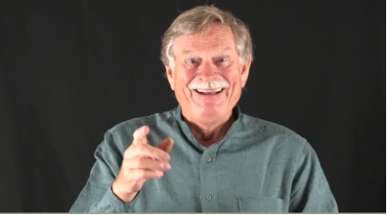
Using storytelling in the language classroom online workshop with Richard Martin
Frightened Mouse: Match the phrases and the screen shots
  He was proud.
  “Oh, I don’t want to be frightened.”
  He was frightened.
  He has an idea.
1
2
3
4

Slide 19
Using storytelling in the language classroom online workshop with Richard Martin
The Frightened Mouse
The magician advertises his services
Class discussion: How might his advertising poster look
  What image
  What text (headline, strapline, contact details, price)
  Create a poster in class – with as much text as appropriate
  Further discussion: Which other clients come – and why?

Slide 20
Using storytelling in the language classroom online workshop with Richard Martin
Tortoise Wins the Spicy Food Competition
Group work – discussion and writing
1. A news reporter from the Animal Times writes a report about the feast.
Structure of a report (headline, byline, body, photo, etc.)
Grammar of a newspaper report (simple past tense, direct speech in quotations, reported speech, etc. Recent classroom grammar teaching can always be included.)
Vocabulary: emotions (angry, surprised, hurt, feel tricked); disapproval (he should not have done it, what we expect of Tortoise, we’ll be more careful next time)
What other details can be included in the report?
2. After the party, the police investigate whether Tortoise has committed a crime.
Partners prepare and conduct an interview with:
  Tortoise
  other animals present at the party
  During the interview, take notes. These are then written into a report. (Appropriate grammar.)

Slide 21
Using storytelling in the language classroom online workshop with Richard Martin
Tortoise Wins the Spicy Food Competition
Group discussion
How and when do the animals understand they have been tricked?
Research – oral and written presentation
Individual or small-group work to find out more about trickster tales:
  Tortoise Called “All of You”
  Till Eulenspiegel
  Anansi

Slide 22
Using storytelling in the language classroom online workshop with Richard Martin
Before we end the workshop,
time for feedback
Comment now - or mail to tales@tellatale.eu

Slide 23
Using storytelling in the language classroom online workshop with Richard Martin
Before we end the workshop,
time for feedback
Comment now - or mail to tales@tellatale.eu
How was it for you?

Slide 24
Using storytelling in the language classroom online workshop with Richard Martin
Before we end the workshop,
time for feedback
Comment now - or mail to tales@tellatale.eu
How was it for you?
Did the workshop meet your expectations?

Slide 25
Using storytelling in the language classroom online workshop with Richard Martin
Before we end the workshop,
time for feedback
Comment now - or mail to tales@tellatale.eu
What about these PowerPoint slides?
Did they help?
Were they annoying?
I’d really like to know your views.

Slide 26
Using storytelling in the language classroom online workshop with Richard Martin
My thanks
To Petra Rauchert for the invitation
To Xaver for the online management
And a final thank-you to you
for joining the workshop
Enjoy your storytelling!
Resource page:
www.tellatale.eu/workshops/links-06-05-21

